Slide 1
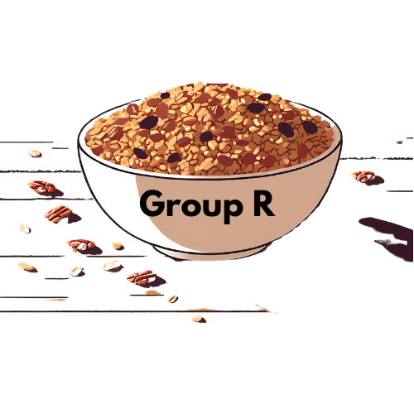
Company R Muesli AG
By: Mina Yousif, Mason Tresham, Nikolas Carruthers, Yuliia Smovzhenko, Kara Stanlake

Slide 2
Review of Team R’s Company Performance
Distribution to three main areas of Germany
Focus on successful products
Good credit score
End Company Evaluation: $18.9M
Notes:
Nik
Our group spent the last year working around the clock to provide germany with the highest quality muesli at the most competitively prices. Working with markets in all three main market areas of Germany we were able to increase our profitability over the year and pulled out company out of a deficit. Through market tests we were able to determine the more profitable products in the german market which we will be sharing with you throughout this presentation. In the end the end we were able to achieve a AA credit score by paying off our loan in a timely and efficient matter and consitistantly reinvesting in ourselves. Throughout the year we analyized every market trend to increase our profitability and ultimately increase our end company evaluation to a staggering 18.9 million.

Slide 3
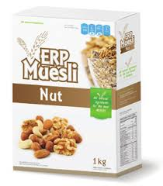
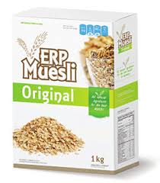
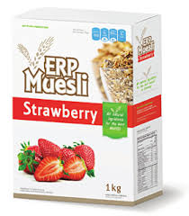
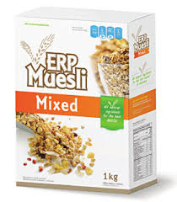
Our Products
Small & Large
Nut Muesli
Small & Large
Original Muesli
Small & Large
Strawberry Muesli
Small Mixed Muesli
Notes:
yuliia
Our company specialized in offering a range of 7 muesli types designed to meet diverse customer preferences. Initially, we started with only 2 flavours, available in both small and large sizes, which were Original and Strawberry. While these were well-received, we recognized the importance of expanding to a wider variety of taste and dietary needs. This led to expansion of our product line to: Nut, Original and Strawberry muesli in Small & Large sizes and mixed muesli in small size. By diversifying our product offering, we successfully attracted more customers and expanded our order volume.
Our company aimed to remain as competitive as possible when pricing our products. To determine initial prices, we calculated the average cost per box of muesli necessary to achieve profitability. By analyzing average market prices and customer demand trends, we adjusted our pricing strategy to balance profitability with market competitiveness.

Slide 4
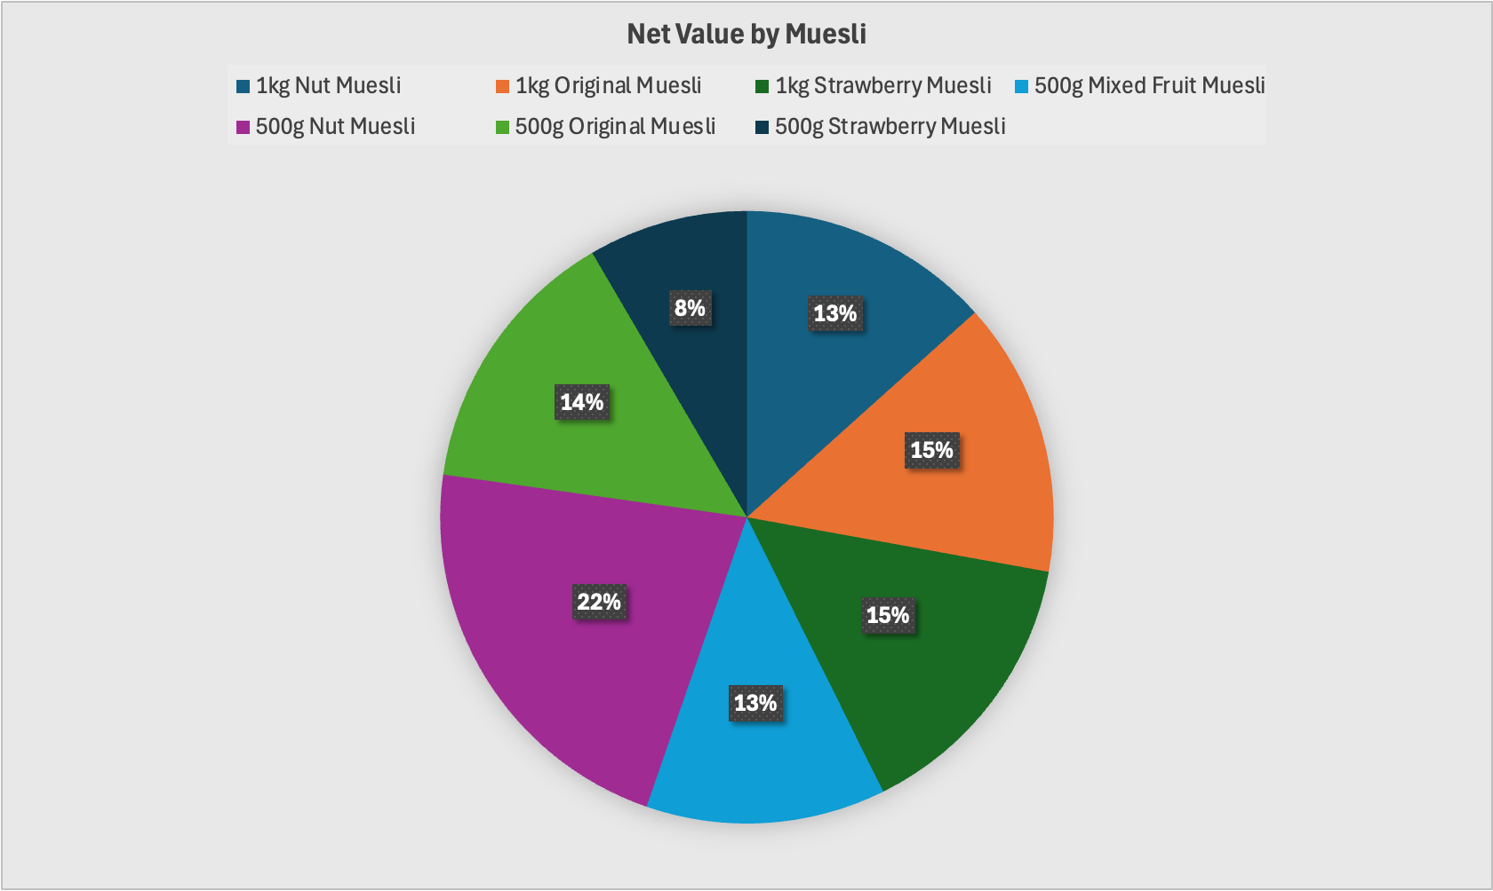
Notes:
Yuliia
Our product Net value graph reflects on the profitability of each product type, highlighting how each flavor and size contributed to our overall financial success. During periods of market competition, the net value of some products fluctuated. Strategic price adjustments allowed us to maintain competitiveness. The graph clearly shows disparities in net value between products. For example, Larger-sized products consistently showed higher net values due to the larger profit margins, as their price offset the slightly increased product cost. Among all products, Strawberry in small size had the lowest net value. This may have been due to higher production cost relative to its lower price point and demand. Overall, This graph shows the opportunities for improvements in the products with lower net value, like Small Strawberry muesli. It can be improved by either optimizing production costs, adjusting prices or improving marketing for particular products.

Slide 5
Our Sales Forecast
500g Nut | 1kg Nut | 500g Original | 1kg Original | 500g Mixed | 500g Strawberry | 1kg Strawberry
48,000 | 48,000 | 48,000 | 48,000 | 24,000 | 24,000 | 24,000
Notes:
Kara
As our pricing/production manager mentioned, we changed our forecast. we decided to do 24,000 and 48,000 (multiple of 24,000) as that was our max capacity for daily production. This helped us to make sure we weren’t wasting any unnecessary time cleaning the equipment between different flavours of muesli.

Slide 6
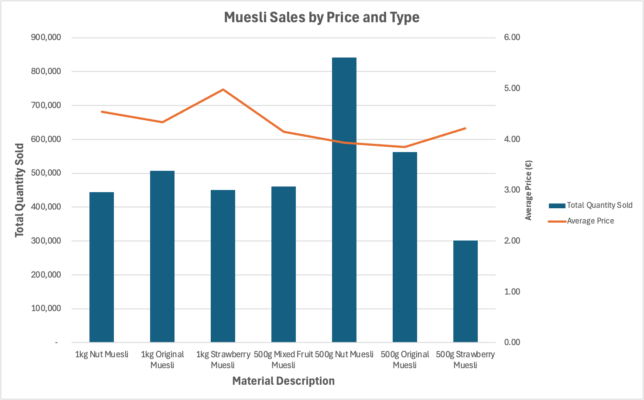
Sales
Notes:
Kara Our prices were decently similar between most of our products, and obviously we were selling our larger 1kg boxes at a higher price point for the most part.
Super important to tread the fine line between covering our costs, but also having a competitive price.
Sold more 500g nut muesli than any other flavour, we were likely undercutting our competitions prices, and this another reason why we decided to increase our sales forecast to 48,000 units since we were clearly selling out of this product so quickly.

Slide 7
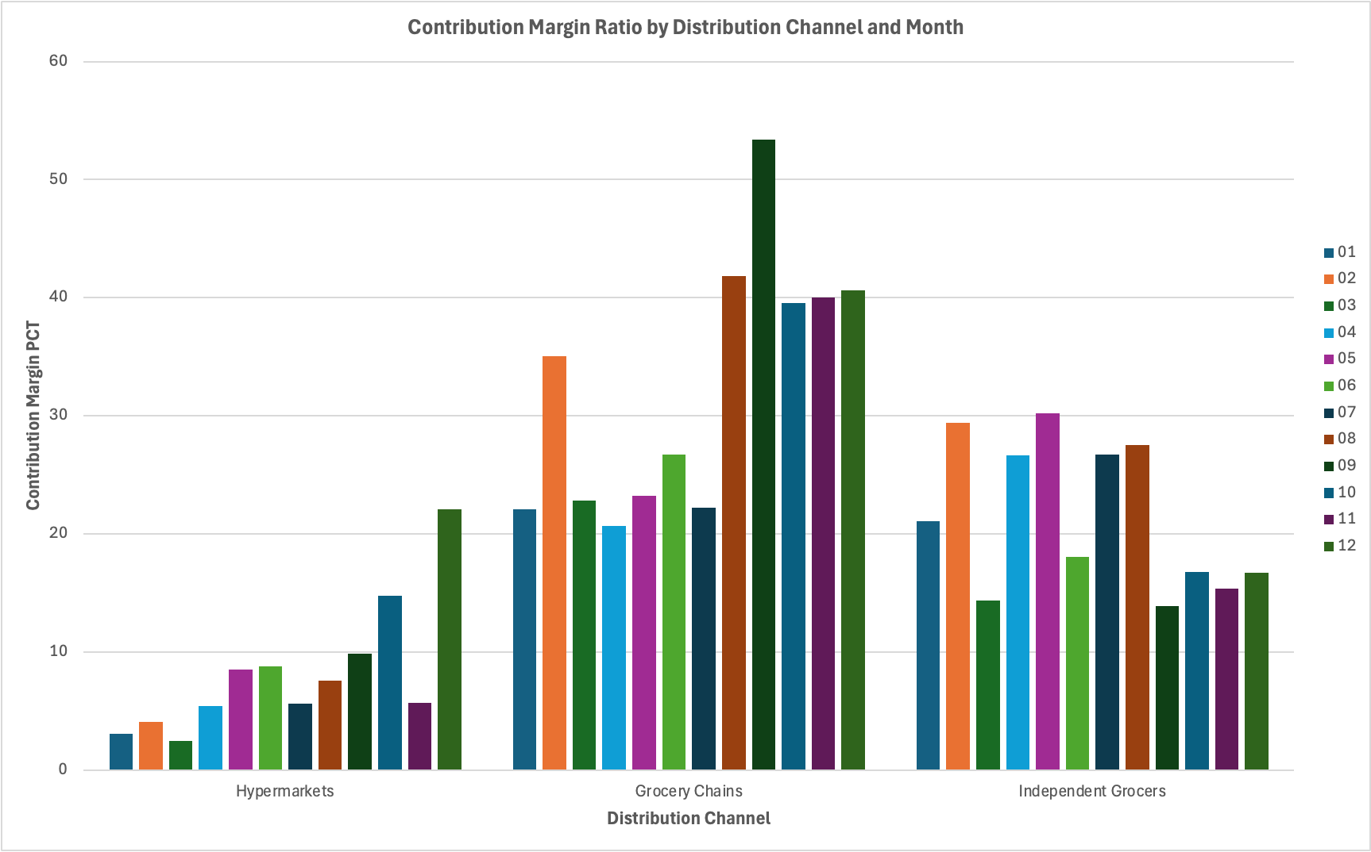
Sales
Notes:
kara
Our contribution margins by months and distribution channel
Excluding independent grocers, we were really able to increase our contribution margin over time as we learned more about our products, the cost to create them and how muhc we could sell them for
CM lowest for hypermarkets, since low prices was incredibly important to maintaining sales in those types of stores. Additionally, only our large muesli’s were being sold here, so our production costs were also higher for these products.
Even though hypermarkets need low prices, we did notice that the CM ratio was just too low for them, so we did increase prices over time to ensure we would be able to cover costs
Grocery chains had the highest CM, this is likely where our most loyal customers were and where our competitors were also pricing their products higher so earn a better profit

Slide 8
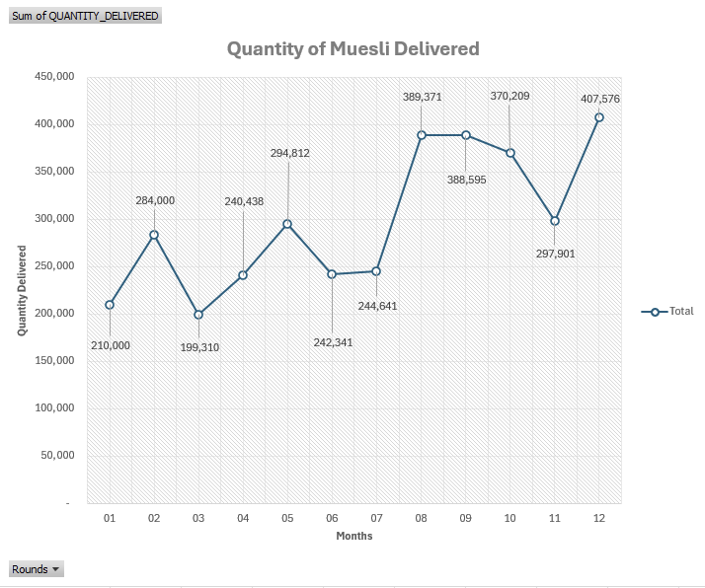
Production
Our company focused on maximizing production capacity while minimizing downtime.
Quickly created new material orders.
Monitored deliveries.

Slide 9
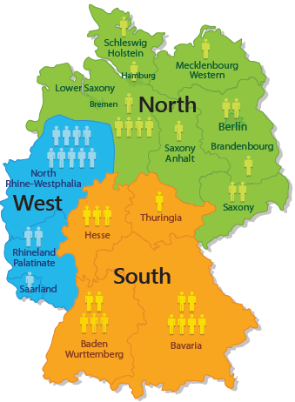
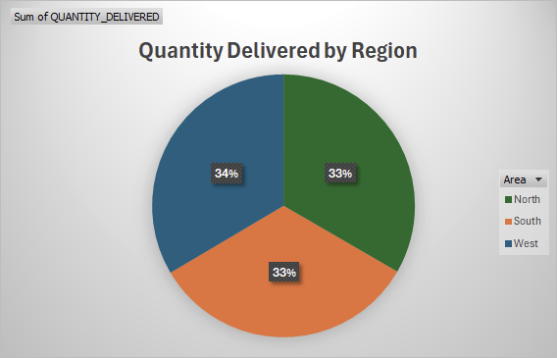
Distribution

Slide 10
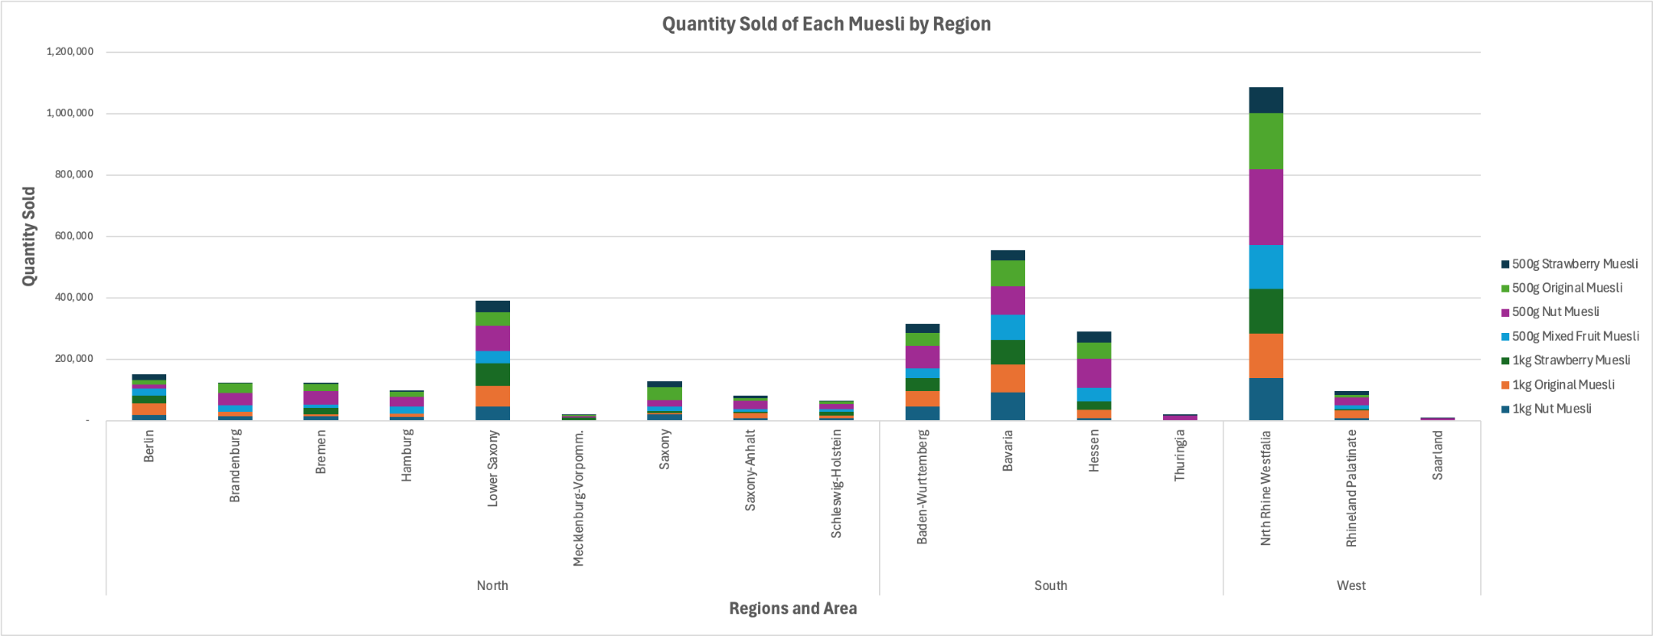
Sales
Notes:
Most popular in Lower Saxony, Bavaria, and North Rhine regions
We want to use this data to develop our push strategy to send further muesli products into these regions since our sales were significantly better here
Definitely want to do some research into why our sales were much lower in certain regions like Thuringia and Saarland, possibly some more marketing.

Slide 11
Investments Made:
01
02
03
Set-Up Time
$1,250,000 (3 hours)
Paying off the Loan
$3,500,000
Marketing (See Next Slide)
Notes:
Hello, my name is Mina and I am the investments manager. Throughout the year, we made various investments to enhance our company and its capabilities. The one thing we invested the most money in was our loan, which was originally 8 Million dollars. We paid off $3,500,000, which is almost half of the loan in order to save money on interest and get out of debt faster. We also spent $1,250,000 on our set up time, reducing it from 8 hours to 3 hours in order for our company to be more efficient. We also invested into marketing.

Slide 12
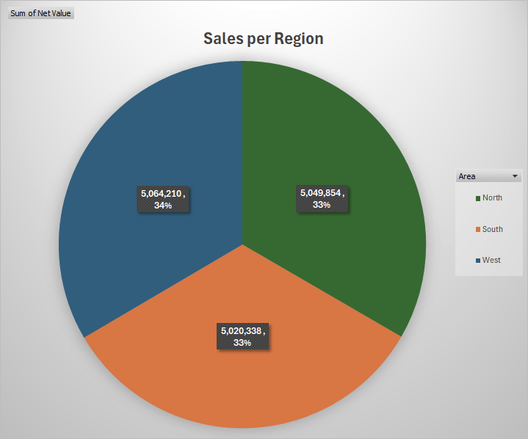
Marketing
Notes:
Throughout the year, we were actively marketing our Muesli products to three regions: North, South, and West. We were constantly changing our marketing strategy, but we invested the same amount of money into marketing for each region. We constantly changed the amount invested into marketing. We noticed that $20 into each product in each region every day was too much and we were not seeing a return on our investment. As a group, we decided to lower it to $12 a day for each product in each region and this was the perfect amount with the most return on our investment. We were using a push marketing campaign to market to hypermarkets, independent grocers, and grocery chains. Which as we can see was effective in reaching the correct people in all markets in every region. As we can see in the graph, sales were evenly distributed throughout all three regions.

Slide 13
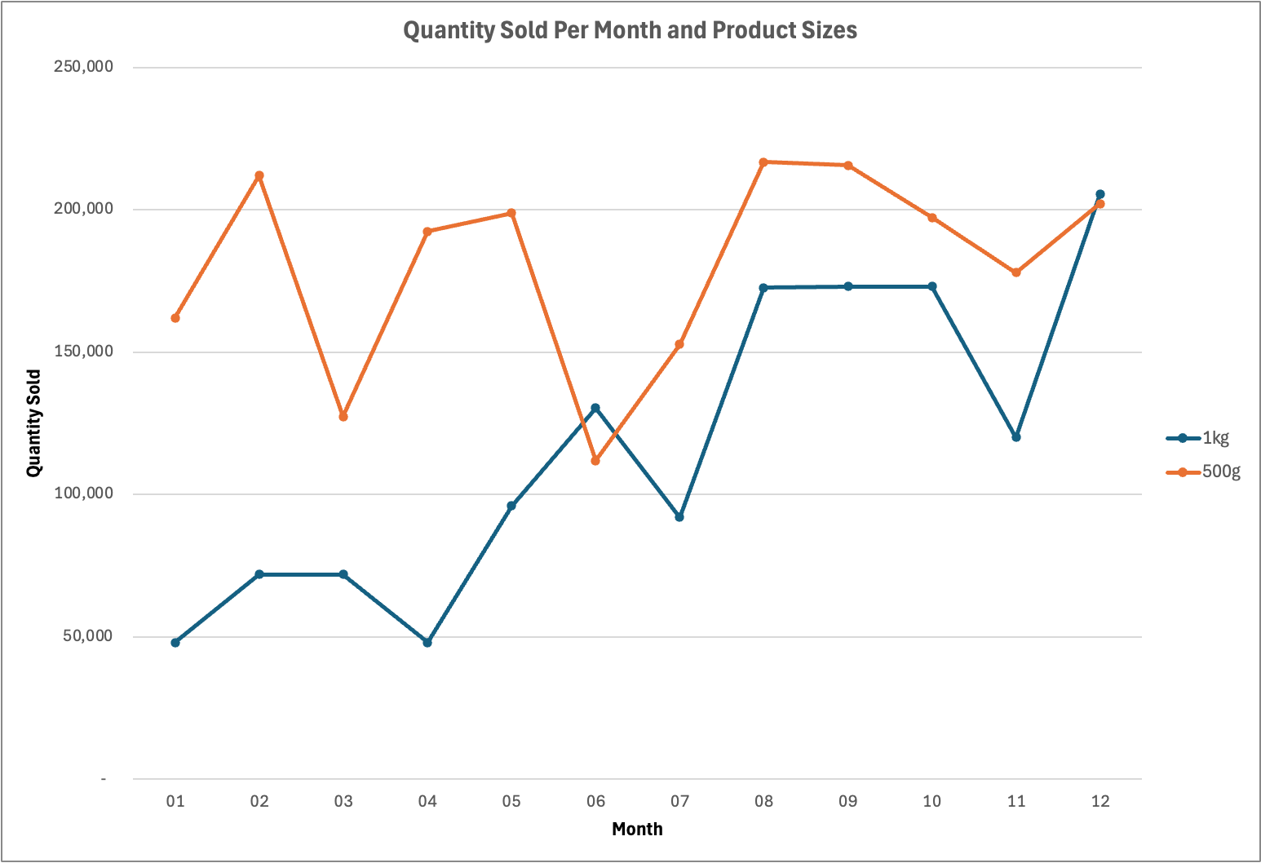
Sales
Notes:
Mina
Throughout the sales for the year, we see a very similar trend for amount of muesli sold per month by box sizes.
Generally speaking, if we noticed a decrease in sales of 500g boxes, the next month saw a decrease in sales of 1kg boxes, so we likely had issues with production at that point in time, or we were being priced out by our competitors

Slide 14
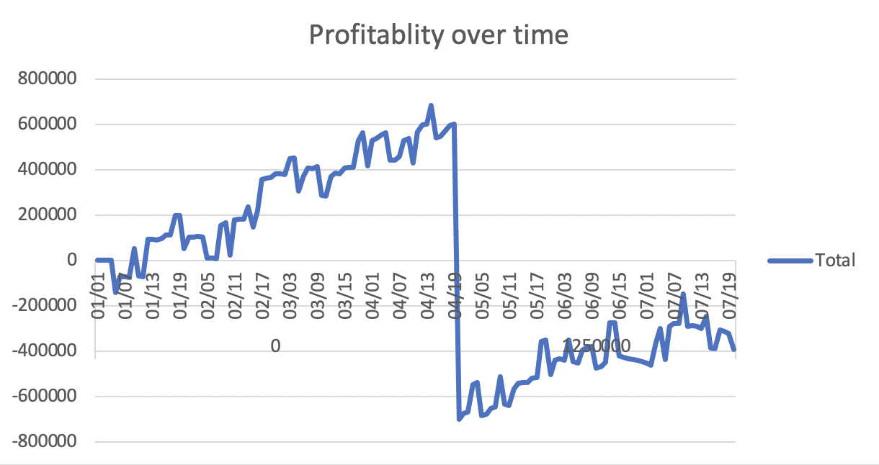
What if reflection:
Less on Marketing
Set up time
Production Cap
Saw little correlation between increased ad spend and sales
Profit in Dollars
Spend less money on decreasing set up time
Time
Spend more on increasing production capacity
Notes:
Nik
Throughout the year we learned a few things about our business and how we can improve our profit and company evaluation for next year. One of the biggest things we noticed was how much we spent on marketing and how little of a difference it made in how much products were sold. We experimented with 10, 12, 15, and 20 dollars of adspend per day without seeing a noteable difference across the variations. In regard to how much monet we spent reinvesting back into our company one of the largest expenses we had this year was our invested in set up time, that came in at a staggering 1.25 mil. Although this investment sounded good in theory, the moment after we spent it we saw out profitability jump into the negatives right away. Although, this was quite disappointing we did recover in Q3 and Q4 which is not pictured here
Next year we would like to investment more in our production capacity in order to produce msuiole quicker and get it out as fast as possible. Throughout the year our muesli was flying off the shelves so by increasing our production capacity we would be able to sell more products and competitive prices.
Given the opportunity this branch would excel beyond your expectations next quarter .

Slide 15
Thank you!

